Slide 1
Matrix Algebra: Application to Orbits
Jack Blair and Daniel DeConti
Notes:
[Jack]: Have you ever wondered, “how many points do I need to construct a given conic section and w

Slide 2

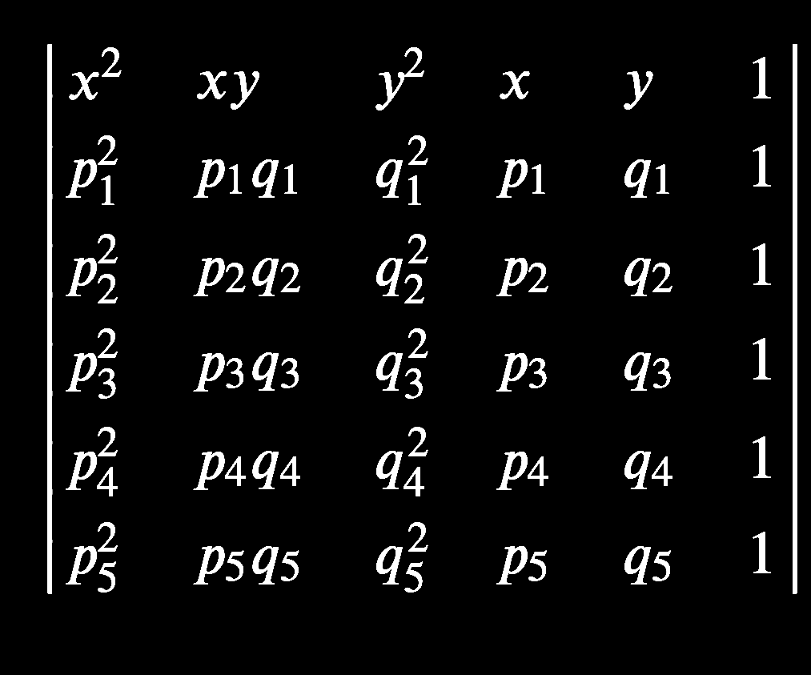

Background
General equation of a conic section:
Ax² + Bxy + Cy² + Dx + Ey + F = 0
Ellipse: A ≠ C and AC > 0; circle if A = C
Hyperbola: AC < 0; parabola: A = 0 xor C = 0
B rotates the function
Can be represented by:
Determinant of a variable-based matrix— det(M) = 0
Null space of an observation-only matrix— Nul(J) via SVD
M =
J =
Notes:
[Daniel]: Okay, so just to recap from TJ Math 5, the general equation for a conic section, that is, any closed or open curve formed from the intersection of a plane and two stacked circular cones, is Ax2 + Bxy + Cy2 + Dx + Ey + F = 0. We can identify the type of conic section by comparing the values of the different coefficients in the discriminant, B^2 - 4AC.
Now, the convenient thing about this equation is that it can be represented by the determinant of a 6 x 6 matrix where the variable terms are in the top row and the remaining five rows are formed by the points that make up the conic section.
This means that a conic section can be determined by exactly five points. As you can see here, the points are inputted into this matrix matching the format of the variable terms, and so when you take the determinant of the matrix and set it to zero, you get a symbolic equation that perfectly models the conic section through the points.

Slide 3
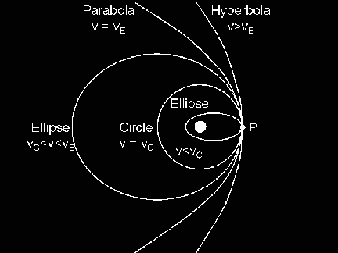
Significance
Kepler’s First Law: All orbits are ellipses
5 observations can plot any conic section
Easy way to model planetary motion
Can also model parabolic and hyperbolic (escape) trajectories
Notes:
[Daniel] I got this

Slide 4

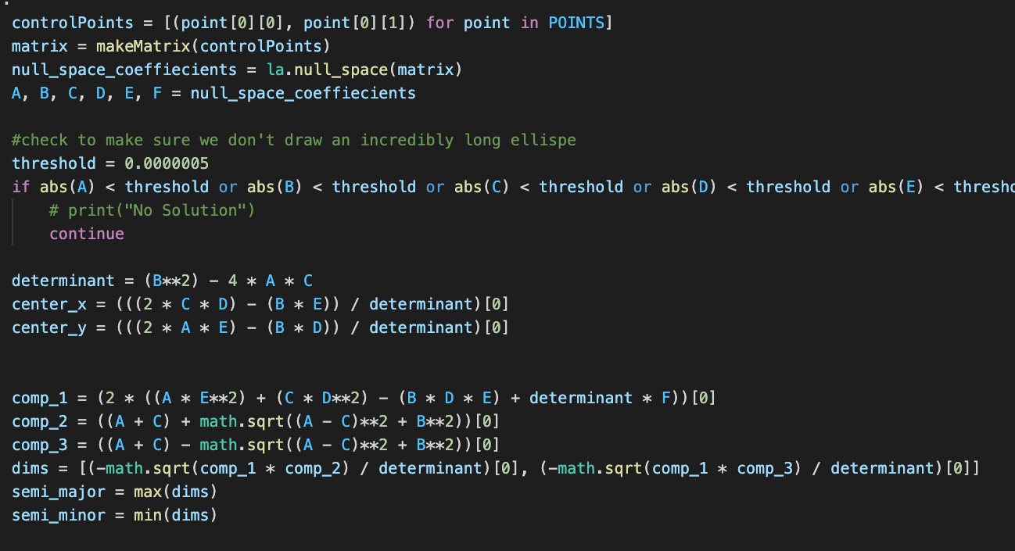
CALCULATION Process
Steps for calculating the trajectory:
Input 5 observations
Find equation of conic
Find det(M) using MATLAB
Find Nul(J) using Python
Determine conic type using discriminant
Trajectory equation found
MATLAB plot with fimplicit
Manual fitting needed
Notes:
Jack

Slide 5
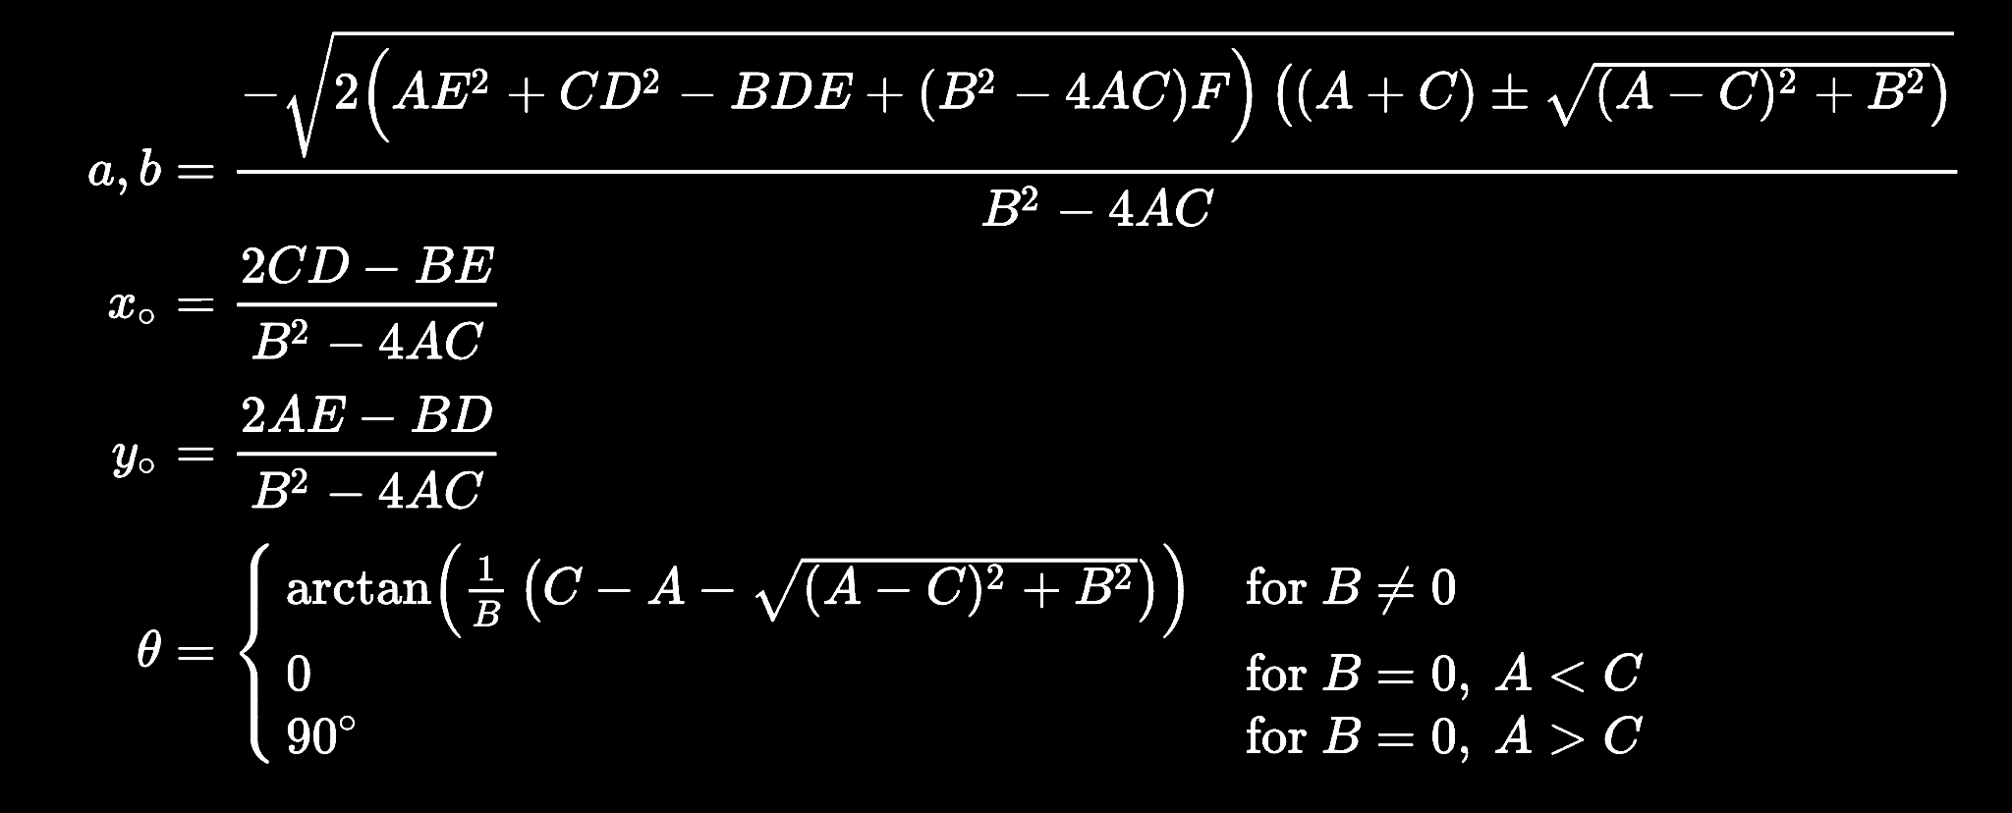
RENDERING Process
Steps for drawing elliptical orbit (in PyGame):
Find semi-major and minor axis, center point, and rotation angle of ellipse
Apply correction factor to rotation
Use PyGame to plot the ellipse
Model planetary motion via parameterized time
For non-elliptical trajectories— inequality field
Notes:
Jack

Slide 6
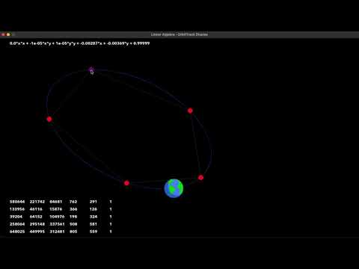
Demonstration
Notes:
Jack

Slide 7


Try It!
P | Q
5 | 6
10 | 4
-2 | 4
-2 | -5
3 | -6
Find the equation of the Planet Kerbal:
Ax² + Bxy + Cy² + Dx + Ey + F = 0
Notes:
-0.018719x\cdot x\ +\ 0.006340xy\ -0.0338y\cdot y\ +\ 0.124396x\ +\ -0.021135y\ +\ 1\ =\ 0

Slide 8
Code
All code is open source at: https://tinyurl.com/orbiTrack
Future ideas:
Conservation of angular momentum (Kepler’s Second Law)
Parameterization of non-elliptical trajectories
Two-body motion (Kepler’s Third Law)
N-body motion (creepy math ensues)
Spheres (require four points)
Notes:
[Daniel]

Slide 9
Sources
Calkins, K. G. (2006). “Numbers and their application - Lesson 19: Quadratic relations and conic sections.” University of St. Andrews, 2006, www.andrews.edu/~calkins/math/webtexts/numb19.htm#BNE0.
Howard, A. & Rorres, C. (2005). Elementary linear algebra with applications. Wiley.
Julien (2014). “Re: How to find an ellipse, given five points?” Mathematics Stack Exchange. www.math.stackexchange.co m/questions/163920/how-to-find-an-ellipse-given-five-points
Pogge, R. W. (2007). “Lecture 19: Orbits.” Ohio State University, www.astronomy.ohio-state.edu/pogge.1/Ast161/Unit4/orbi ts.html.
Wikipedia Editors (2022). “Ellipses: General ellipse” Wikipedia, www.en.wikipedia.org/wiki/Ellipse#General_ellipse
Wikipedia Editors (2022). “Matrix representation of conic sections.” Wikipedia, www.en.wikipedia.org/wiki/Matrix_rep resentation_of_conic_sections#Central_conics
Notes:
[Daniel]

Slide 10
Questions?
Notes:
[Daniel]

